Slide 1

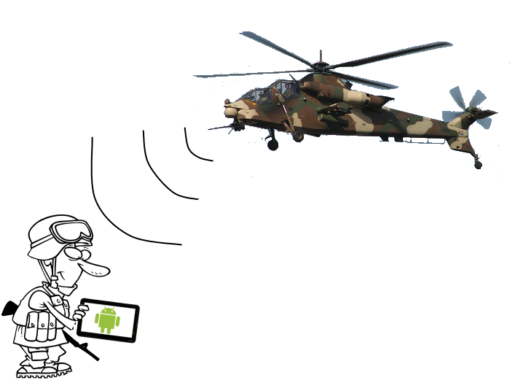
Raytheon Senior Design Project Android Based Situational Awareness: Moving Map
Gate 7: CDR
February 18, 2013

Slide 2
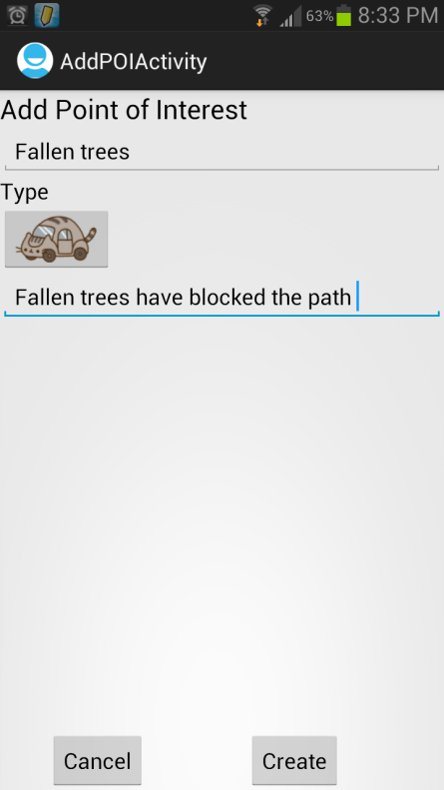
Project Overview
Background: There are no current Raytheon non-web based mapping applications on an Android device.
CONOPS: (Concept of Operations) The application is intended for soldiers, law enforcement officers, or other personnel without access to the Internet. The application will be compatible with Android devices.
Key Assumptions:
Application can smoothly synchronize with support server
Android device can cache enough map data to allow for smooth map transitions
Critical Success Factors:
Final Release by 4/2
Test Plan by 3/20
Buyoff Criteria:
Final Release Demonstration for Raytheon Management
Successful completion of all university project requirements
Deliverables:
Program Documentation (Schedule, etc.)
Requirements/Architecture
System Design
Source Code/Executables
Demonstrations
Next Milestone:
Test Readiness Review (CDR) – 20 Mar 2013

Slide 3
Scenario
Rescue team assigned to natural disaster relief
No access to external Internet
Need access to maps
Need ability to mark downed trees, power lines, rescue locations, etc.
Need ability to share data to other devices on the network

Slide 4
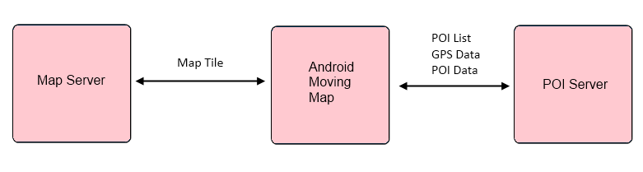
Birds Eye View

Slide 5
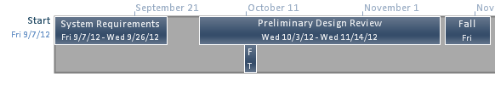
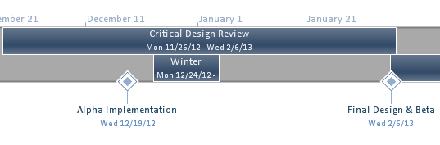
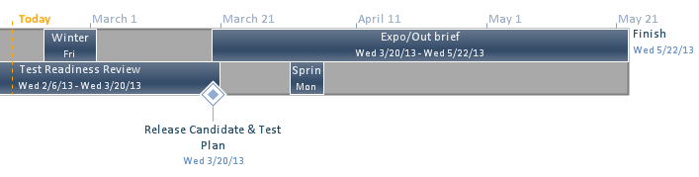
Project Schedule

Slide 6
Backup Slides
Include extra slides if discussion goes ‘deeper’ and all slides from after meeting

Slide 7
Functional Requirements
ID | Requirement | Priority
FR0 | The system shall let the user pan the map by a dragging gesture | Objective
FR1 | The system shall let the user zoom using an on-screen button | Threshold
FR2 | The system shall let the user zoom using pinch gestures | Objective
FR3 | The system shall let the user zoom using double tap | Objective
FR4 | The system shall store map tiles on the device | Threshold
FR5 | The system shall display map tiles which are stored on the device | Threshold
FR6 | The system shall be able to pull map tiles which are stored on a local server and store them on the device | Objective
FR7 | The system shall georeference the location of the device | Threshold
FR8 | The system shall let the user center on current location | Objective
FR9 | The system shall store multiple map types | Threshold
FR10 | The system shall let the user choose the map type | Objective
FR11 | The system shall store points of interest as a map overlay | Objective

Slide 8
Functional Requirements
ID | Requirement | Priority
FR12 | The system shall display points of interest overlays | Objective
FR13 | The system shall let the user choose which overlays are displayed | Objective
FR14 | The system shall let the user add custom points of interest | Objective
FR15 | The system shall let the user choose which overlay the custom point of interest is added to | Objective
FR16 | The system shall let the user create new overlays | Objective
FR17 | The system shall display a compass | Threshold
FR18 | The system shall let the user toggle heading/north up | Threshold
FR19 | The system shall let the user change default settings via a settings menu found in the menu bar | Threshold
FR20 | The system shall let the user access a help menu via the menu bar | Objective

Slide 9
Deliverable Diagrams
High Level Overview
Details a high level overview of the system
Package Diagram
Defines system modules and details their high level interactions
System Sequence Diagrams
These SSDs help describe the interaction between Android app and server, specifically with regards to the protocol of fetching map data (known as “tiles”) and receiving point of interest (POI) data.
UML Class Diagram
Shows all the components of the system and their interactions and dependencies

Slide 10
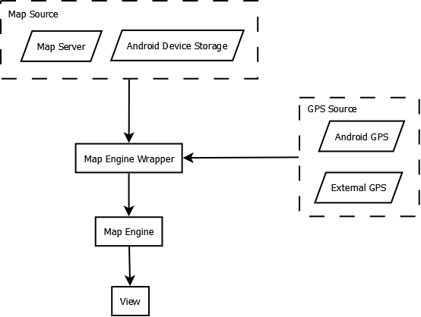
High Level Architecture

Slide 11
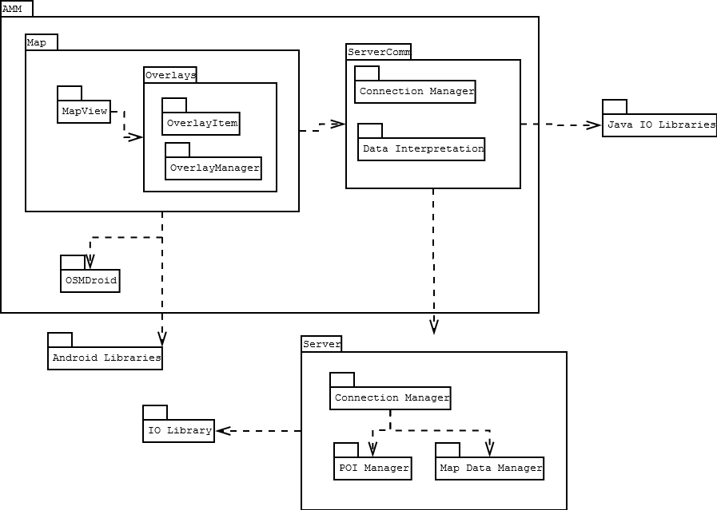
Package Diagram

Slide 12
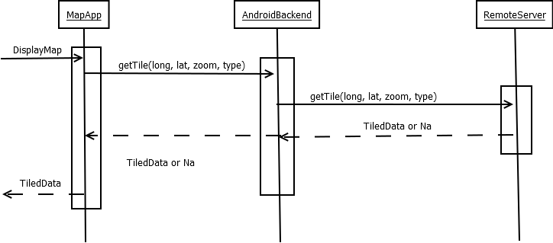
Get Map Tile Sequence

Slide 13
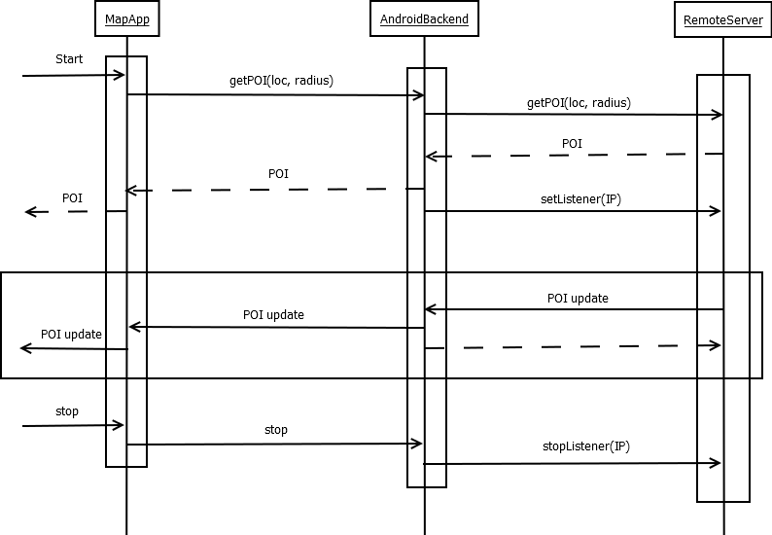
Get POI Sequence

Slide 14
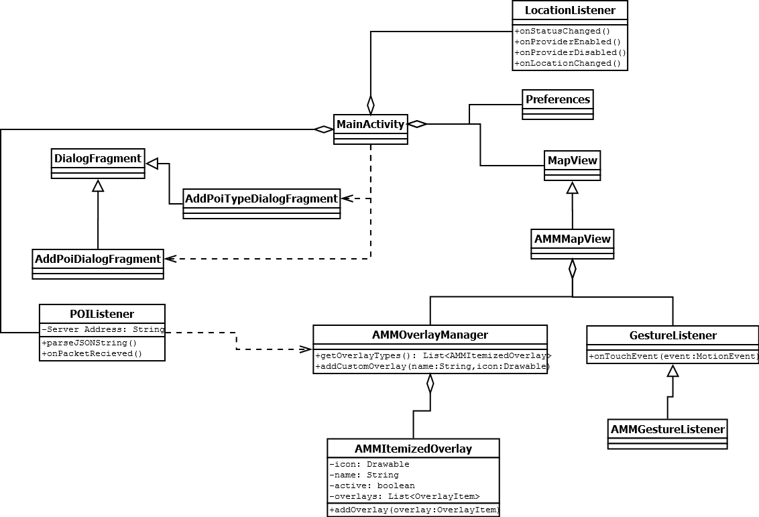
Class Diagram

Slide 15
Project Schedule & Milestones
System Requirements Review: September 26th
Preliminary Design Review: November 14th
Alpha Release: December 19th
Beta Release: February 6th
Critical Design Review: February 6th
Test Readiness Review: March 20th
Final Release: April 17th
Expo/Out brief: May 22nd

Slide 16
Project Team
Todd Lovell
Chief Engineer
Doug Dusseau
Subject Matter Expert
J.D. Hill
Program Engineer
Michael Wollowski
Project Advisor
Tom Atnip
Team Leader
Software Engineer
Susi Cisneros
Client Contact
Software Engineer
Sam Kim
Software Engineer
Seth Troisi
Software Engineer

Slide 17
Assumptions, Risks, & Opportunities
Risks
Performance of the system
Organizing data in the correct format in a timely manner
Assumptions
Map data exists in a format that can be easily manipulated
Android device can cache enough map data to allow for smooth map transitions
Opportunities
Finding a feature complete mapping engine

Slide 18
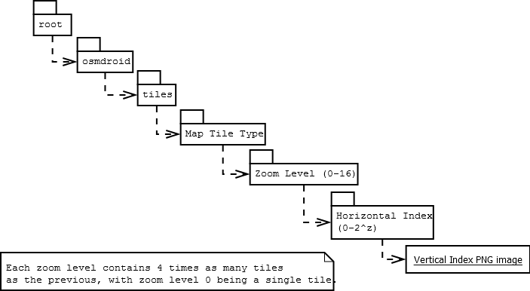
Map Tile Folder Structure

